Slide 1
Ultimate Spreadsheet Charts for Business Infographics
Antonio de Jesús Muñoz Muñoz 23130562
Agustín Alexis Reyes Castillo 23130568

Slide 2
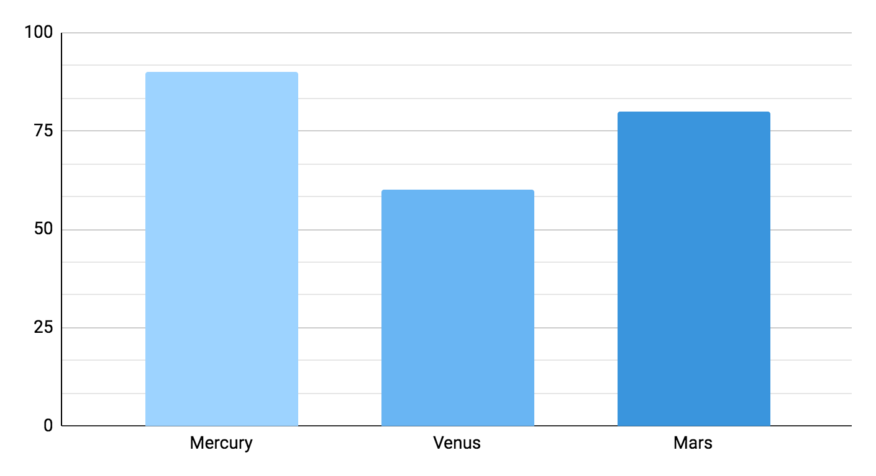
Ultimate spreadsheet charts for business infographics
01
Mercury
Mercury is the closest planet to the Sun
02
Venus
Venus has a beautiful name but is hot
03
Mars
Despite being red, Mars is a cold place
90%
60%
80%
Follow the link in the graph to modify its data and then paste the new one here. For more info, click here

Slide 3

Ultimate spreadsheet charts for business infographics
Jupiter
Neptune
Jupiter is a gas giant and the biggest planet
Neptune is the farthest planet from the Sun
40%
10%
Mercury
Mars
Mercury is the closest planet to the Sun
Despite being red, Mars is a cold place
30%
20%
Follow the link in the graph to modify its data and then paste the new one here. For more info, click here

Slide 4
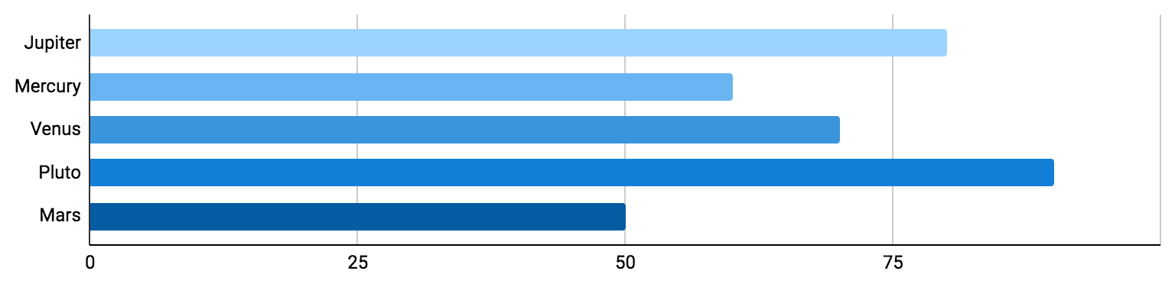
Ultimate spreadsheet charts for business infographics
80%
60%
70%
90%
50%
Jupiter
Mercury
Venus
Pluto
Mars
Jupiter is a gas giant and the biggest planet
Mercury is the closest planet to the Sun
Venus has extremely hot temperatures
Pluto is considered a dwarf planet
Despite being red, Mars is a very cold place
Follow the link in the graph to modify its data and then paste the new one here. For more info, click here

Slide 5
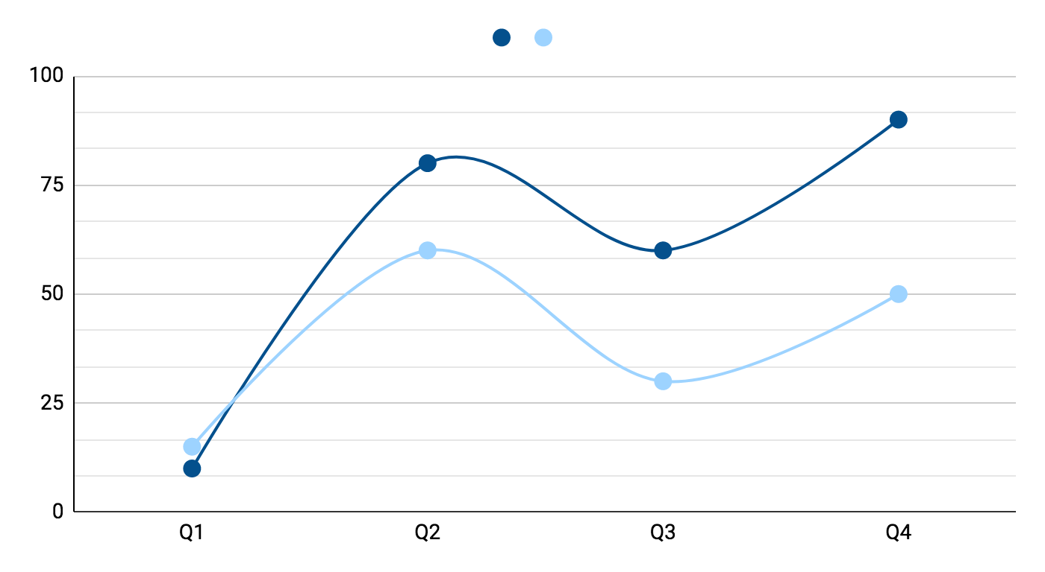
Ultimate spreadsheet charts for business infographics
01
02
Jupiter
Mercury
Jupiter is a gas giant and the biggest planet
Mercury is the closest planet to the Sun
30%
70%
Follow the link in the graph to modify its data and then paste the new one here. For more info, click here

Slide 6
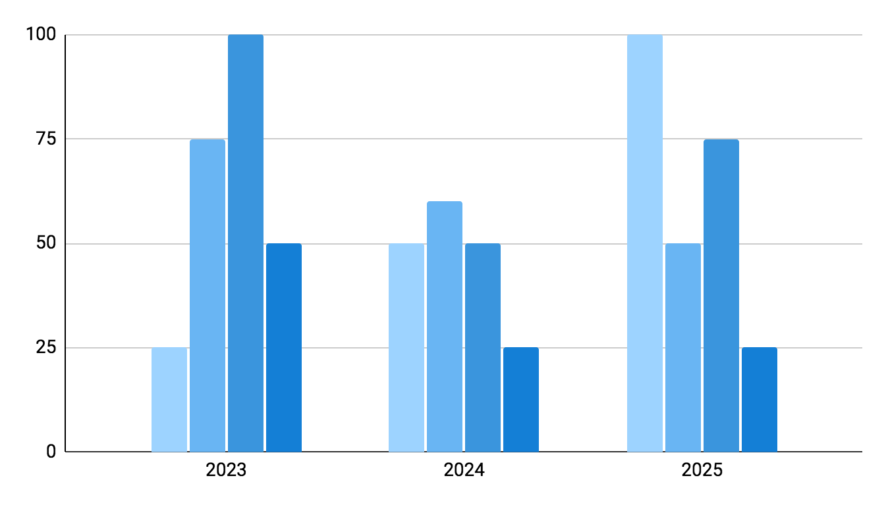
Ultimate spreadsheet charts for business infographics
Neptune
Neptune is the farthest planet from the Sun
Mars
Despite being red, Mars is a cold place
Pluto
Pluto is considered a dwarf planet
Ceres
Ceres is located in the main asteroid belt
Follow the link in the graph to modify its data and then paste the new one here. For more info, click here

Slide 7
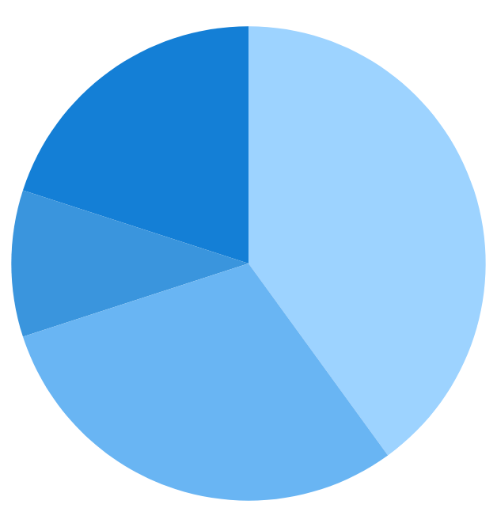
Ultimate spreadsheet charts for business infographics
40%
30%
Jupiter
Mercury
Jupiter is the biggest planet of them all
Mercury is the closest planet to the Sun
10%
20%
Venus
Pluto
Venus has very high temperatures
Pluto is considered a dwarf planet
Follow the link in the graph to modify its data and then paste the new one here. For more info, click here

Slide 8
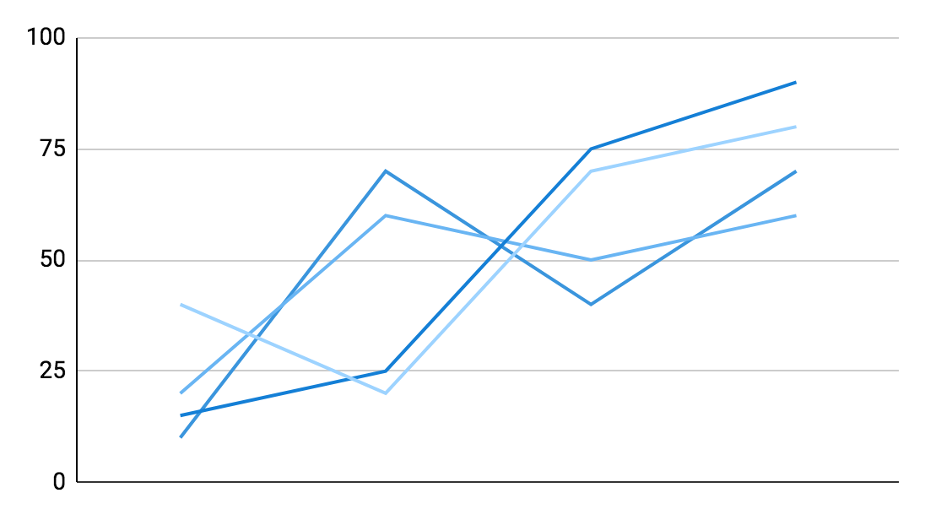
Ultimate spreadsheet charts for business infographics
Annual profit
Earth is the third planet from the Sun and the only one that harbors life in the Solar System
Q1 | +1,200
Q2 | +1,600
Q3 | +2,200
Q4 | +3,100
Follow the link in the graph to modify its data and then paste the new one here. For more info, click here

Slide 9
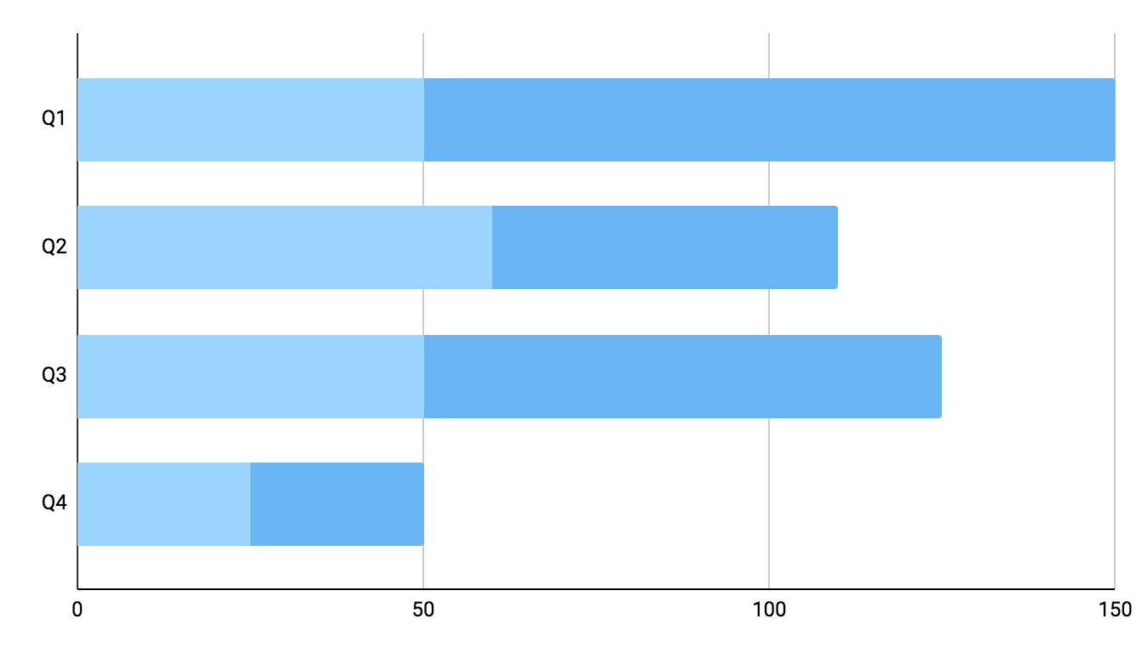
Ultimate spreadsheet charts for business infographics
Jupiter
Jupiter is the biggest planet of them all
Mercury
Mercury is the closest planet to the Sun
Follow the link in the graph to modify its data and then paste the new one here. For more info, click here

Slide 10
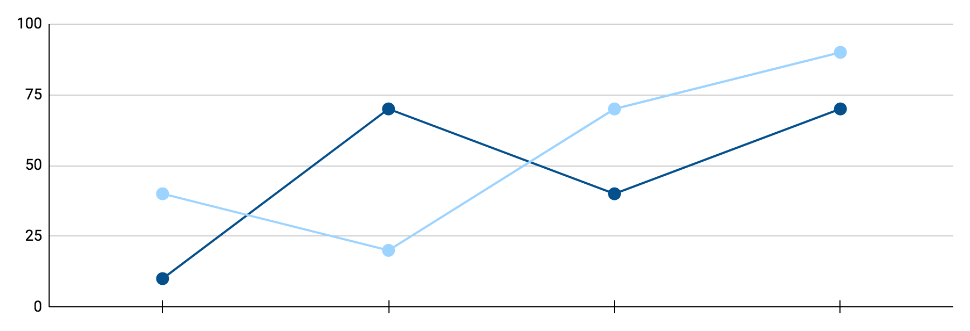
Ultimate spreadsheet charts for business infographics
Mercury
Jupiter
Mercury is the closest planet to the Sun
Jupiter is a gas giant and the biggest planet
+ 30%
+40%
Follow the link in the graph to modify its data and then paste the new one here. For more info, click here

Slide 11
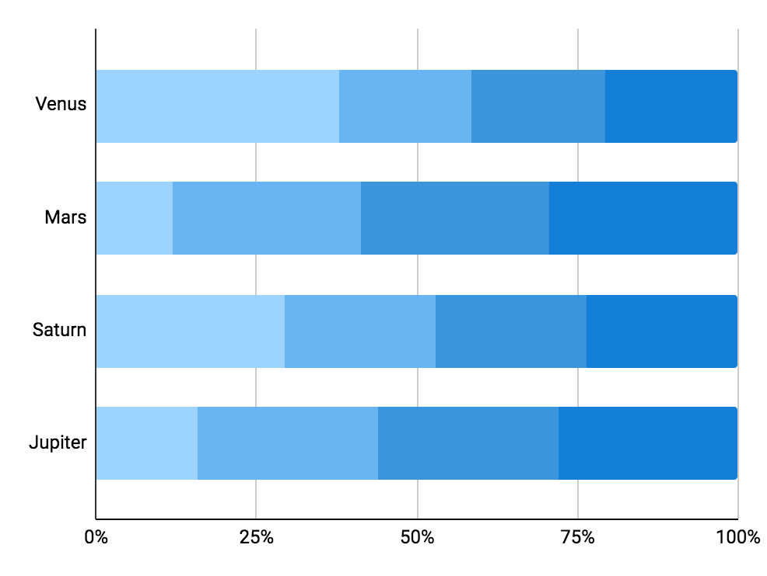
Ultimate spreadsheet charts for business infographics
Jupiter
Neptune
Jupiter is the biggest planet
It’s the farthest planet from the Sun
Mercury
Mars
Mercury is the smallest planet
Despite being red, Mars is a cold place
Follow the link in the graph to modify its data and then paste the new one here. For more info, click here

Slide 12
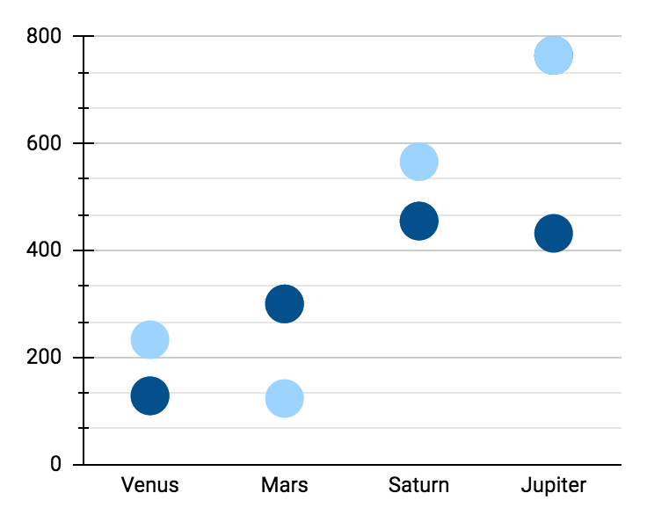
Ultimate spreadsheet charts for business infographics
Jupiter
Mercury
Jupiter is a gas giant and the biggest planet
Mercury is the closest planet to the Sun
01
02
Follow the link in the graph to modify its data and then paste the new one here. For more info, click here

Slide 13
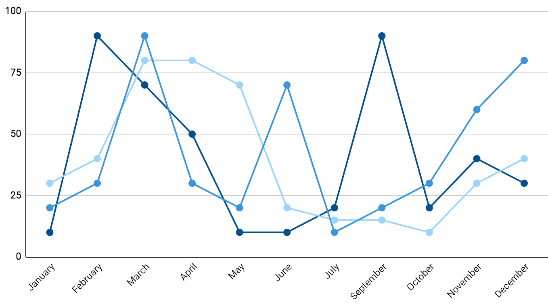
Ultimate spreadsheet charts for business infographics
Mercury
40%
Mercury is the closest planet to the Sun
Venus
20%
Venus has a beautiful name but is hot
Mars
60%
Despite being red, Mars is a cold place
Follow the link in the graph to modify its data and then paste the new one here. For more info, click here

Slide 14
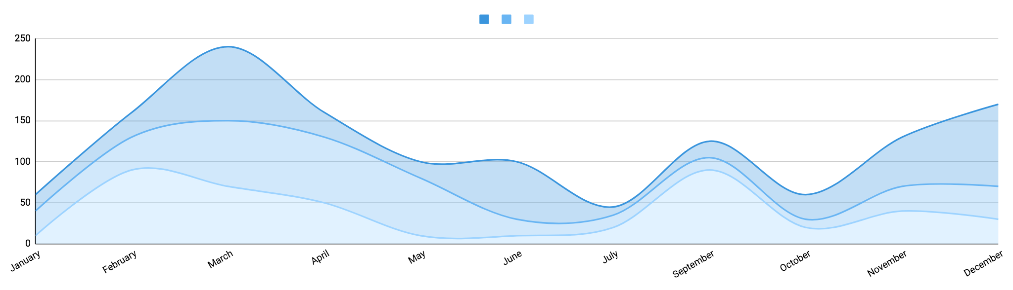
Ultimate spreadsheet charts for business infographics
Mercury
Mars
Jupiter
Mercury is the closest planet to the Sun
Despite being red, Mars is a cold place
Jupiter is a gas giant and the biggest planet
+20%
+30%
+50%
Follow the link in the graph to modify its data and then paste the new one here. For more info, click here

Slide 15
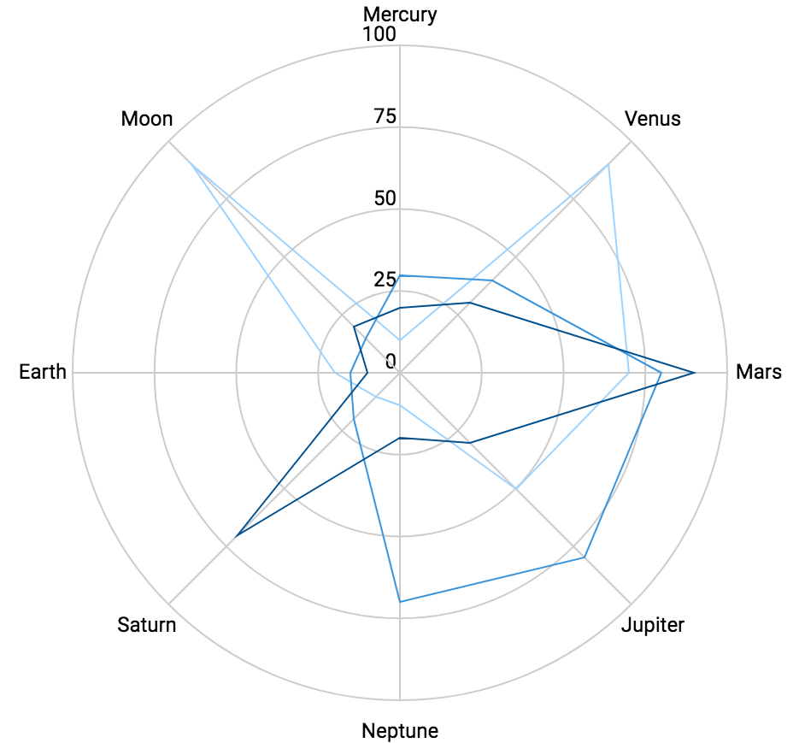
Ultimate spreadsheet charts for business infographics
Mercury
Mercury is the closest planet to the Sun
Venus
Venus has a beautiful name but is hot
Mars
Despite being red, Mars is a cold place
Follow the link in the graph to modify its data and then paste the new one here. For more info, click here

Slide 16
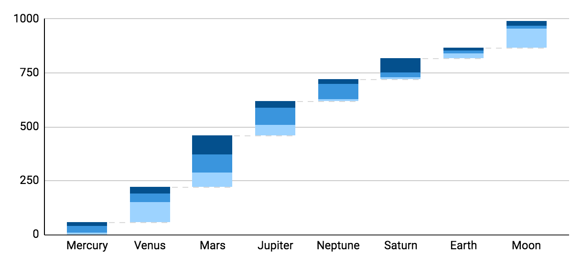
Ultimate spreadsheet charts for business infographics
30%
Mercury
Mercury is the closest planet to the Sun
20%
Pluto
Pluto is considered a dwarf planet
10%
Venus
Venus has very high temperatures
Follow the link in the graph to modify its data and then paste the new one here. For more info, click here

Slide 17
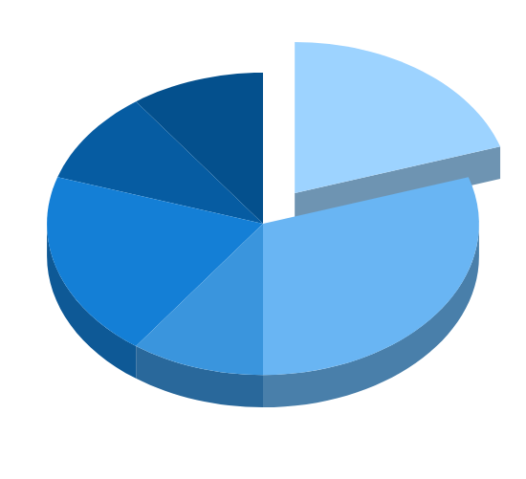
Ultimate spreadsheet charts for business infographics
Jupiter
Neptune
Jupiter is a gas giant and the biggest planet
Neptune is the farthest planet from the Sun
10%
20%
Mercury
Mars
Mercury is the closest planet to the Sun
Despite being red, Mars is a cold place
10%
30%
Venus
Pluto
Venus has a beautiful name but is hot
Pluto is considered a dwarf planet
20%
10%
Follow the link in the graph to modify its data and then paste the new one here. For more info, click here

Slide 18
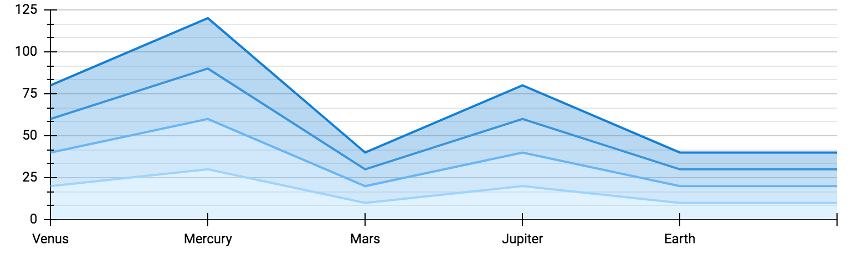
Ultimate spreadsheet charts for business infographics
+60%
-30%
+40%
+20%
Mercury
Mars
Jupiter
Neptune
Mercury is the closest planet to the Sun
Despite being red, Mars is a cold place
Jupiter is a gas giant and the biggest planet
It’s the farthest planet from the Sun
Follow the link in the graph to modify its data and then paste the new one here. For more info, click here

Slide 19
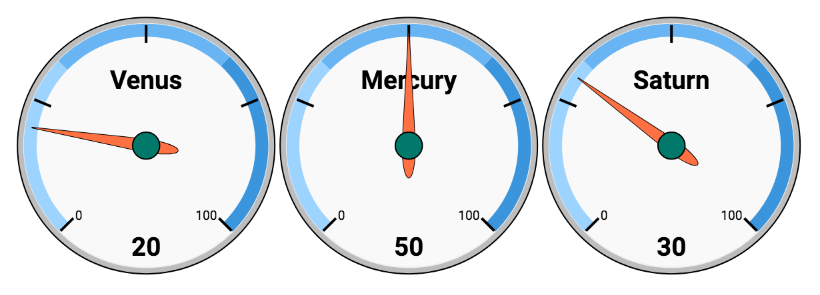
Ultimate spreadsheet charts for business infographics
Mercury
Mars
Jupiter
Mercury is the closest planet to the Sun
Despite being red, Mars is a cold place
Jupiter is a gas giant and the biggest planet
Follow the link in the graph to modify its data and then paste the new one here. For more info, click here

Slide 20
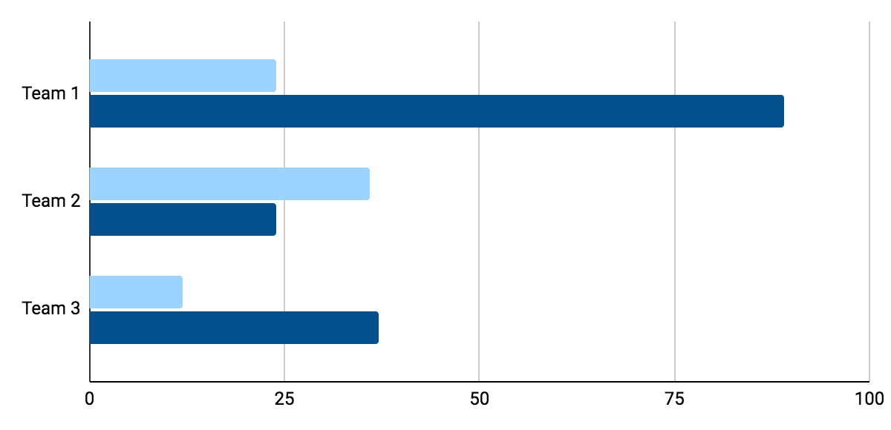
Ultimate spreadsheet charts for business infographics
Period 1
20%
Jupiter is a gas giant and the biggest planet
80%
30%
20%
Period 2
10%
Mercury is the closest planet to the Sun
35%
Follow the link in the graph to modify its data and then paste the new one here. For more info, click here

Slide 21
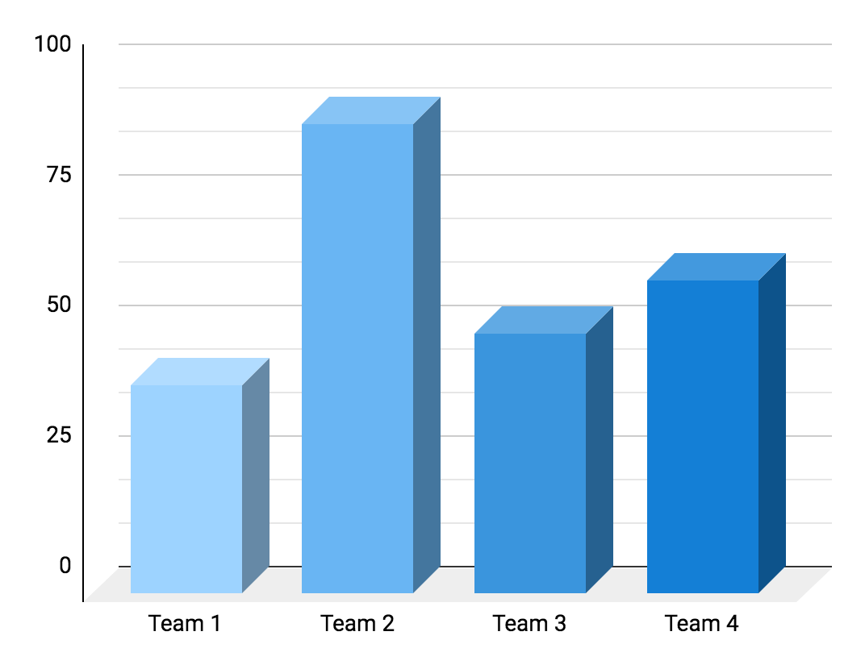
Ultimate spreadsheet charts for business infographics
40%
90%
Team 1
Team 2
Jupiter is the biggest planet of them all
Mercury is the closest planet to the Sun
50%
60%
Team 3
Team 4
Venus has a nice name but is very hot
Pluto is considered a dwarf planet
Follow the link in the graph to modify its data and then paste the new one here. For more info, click here

Slide 22
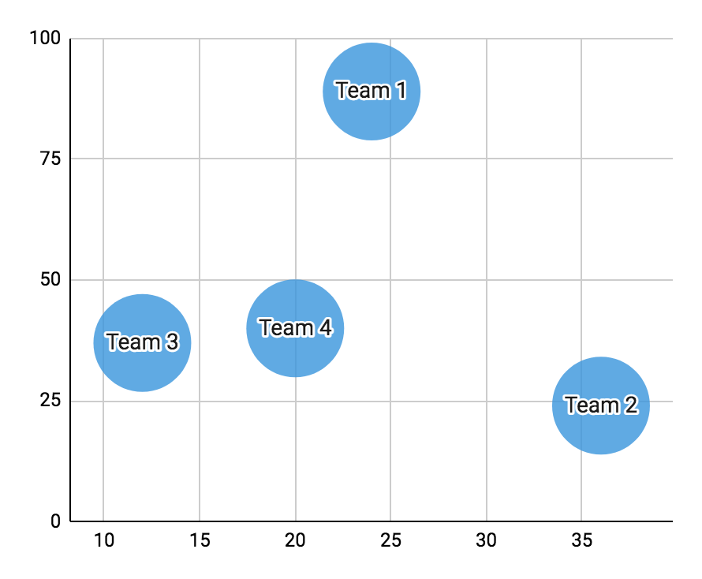
Ultimate spreadsheet charts for business infographics
Team 1
Team 2
Jupiter is the biggest planet of them all
Mercury is the closest planet to the Sun
Team 3
Team 4
Venus has a nice name but is very hot
Pluto is considered a dwarf planet
Follow the link in the graph to modify its data and then paste the new one here. For more info, click here

Slide 23
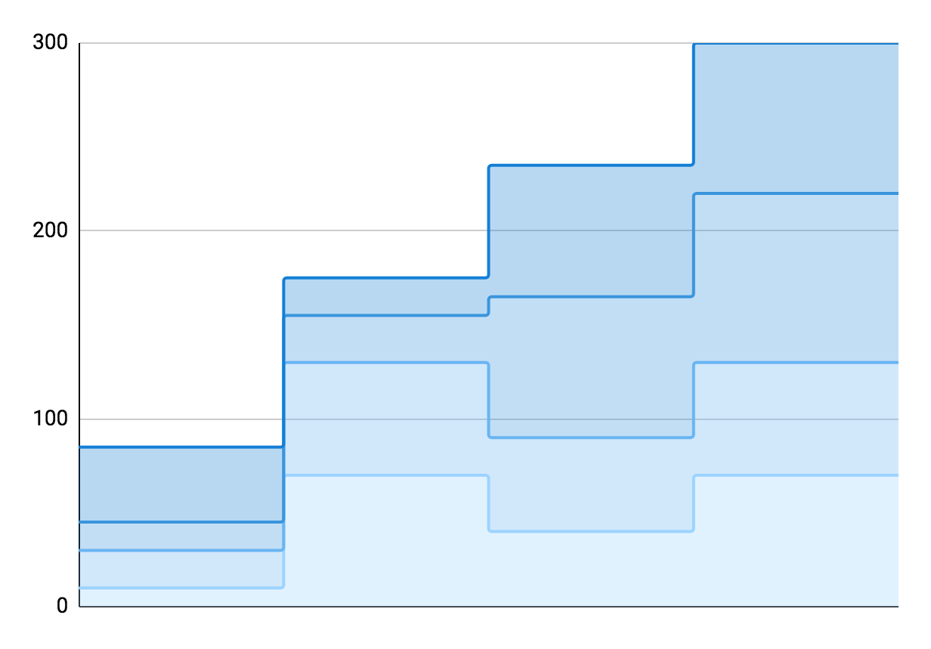
Ultimate spreadsheet charts for business infographics
Jupiter
Jupiter is a gas giant and the biggest planet
Mercury
Mercury is the closest planet to the Sun
Venus
Venus has a beautiful name but is hot
Earth
Earth is the third planet from the Sun
Follow the link in the graph to modify its data and then paste the new one here. For more info, click here

Slide 24
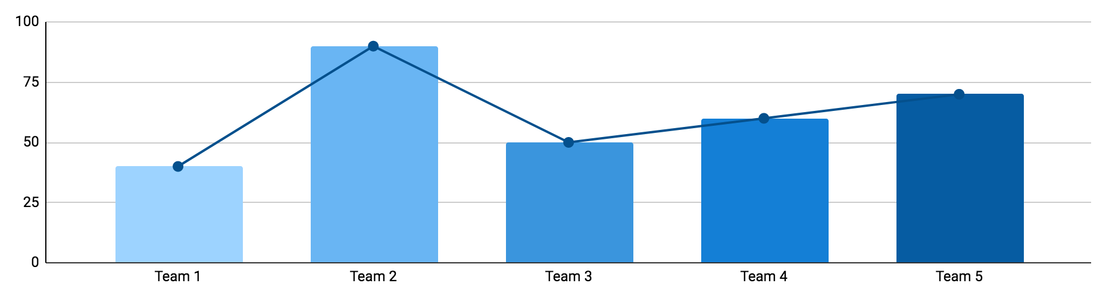
Ultimate spreadsheet charts for business infographics
30%
90%
50%
60%
70%
Jupiter
Mercury
Venus
Pluto
Mars
Jupiter is a gas giant and the biggest planet
Mercury is the closest planet to the Sun
Venus has extremely hot temperatures
Pluto is considered a dwarf planet
Despite being red, Mars is a very cold place
Follow the link in the graph to modify its data and then paste the new one here. For more info, click here

Slide 25

Ultimate spreadsheet charts for business infographics
Neptune
40%
Neptune is the farthest planet from the Sun
Mars
10%
Despite being red, Mars is a cold place
Pluto
30%
Pluto is considered a dwarf planet
Ceres
20%
Ceres is located in the main asteroid belt
Follow the link in the graph to modify its data and then paste the new one here. For more info, click here

Slide 26
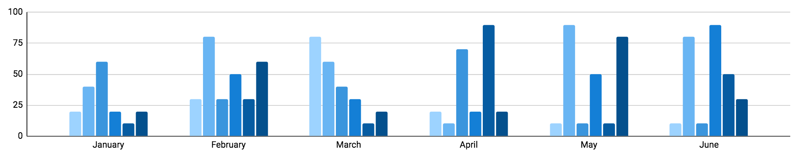
Ultimate spreadsheet charts for business infographics
Jupiter
Mercury
Venus
Pluto
Mars
Neptune
Jupiter is the biggest planet of them all
Mercury is the closest planet to the Sun
Venus has very high temperatures
Pluto is considered a dwarf planet
Despite being red, Mars is a cold place
Neptune is very far from the Sun
Follow the link in the graph to modify its data and then paste the new one here. For more info, click here

Slide 27
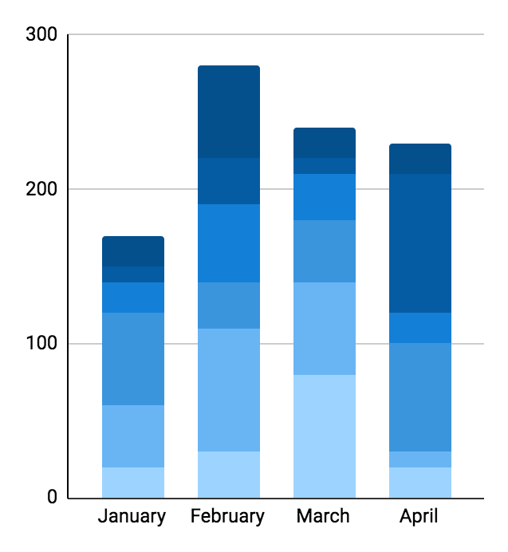
Ultimate spreadsheet charts for business infographics
+30%
+40%
Jupiter
Neptune
Jupiter is a gas giant and the biggest planet
Neptune is the farthest planet from the Sun
+20%
+50%
Mercury
Mars
Mercury is the closest planet to the Sun
Despite being red, Mars is a cold place
+10%
+60%
Venus
Pluto
Venus has a beautiful name but is hot
Pluto is considered a dwarf planet
Follow the link in the graph to modify its data and then paste the new one here. For more info, click here

Slide 28
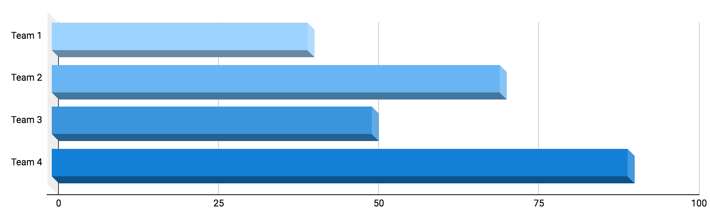
Ultimate spreadsheet charts for business infographics
40%
70%
50%
90%
Mercury
Mars
Jupiter
Neptune
Mercury is the closest planet to the Sun
Despite being red, Mars is a cold place
Jupiter is a gas giant and the biggest planet
It’s the farthest planet from the Sun
Follow the link in the graph to modify its data and then paste the new one here. For more info, click here

Slide 29
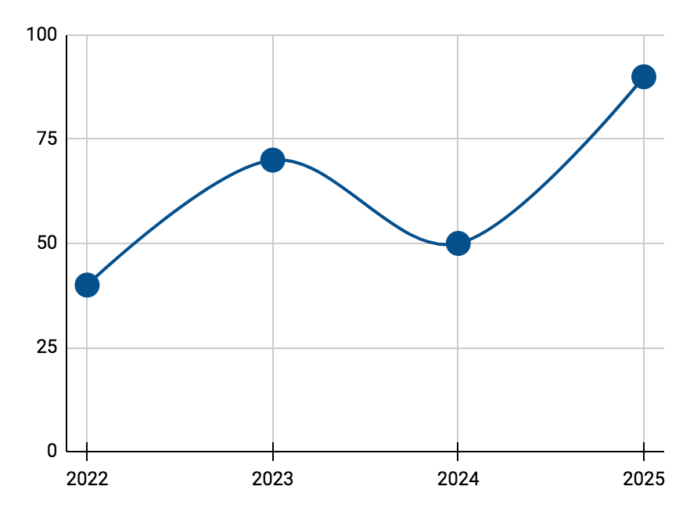
Ultimate spreadsheet charts for business infographics
2022
40%
Neptune is the farthest planet from the Sun
2023
70%
Despite being red, Mars is a cold place
2024
50%
Pluto is considered a dwarf planet
2025
90%
Ceres is located in the main asteroid belt
Follow the link in the graph to modify its data and then paste the new one here. For more info, click here

Slide 30
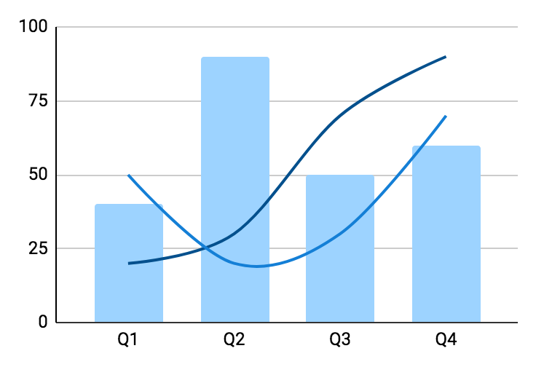
Ultimate spreadsheet charts for business infographics
Neptune
Neptune is the farthest planet from the Sun
+40%
Mars
Despite being red, Mars is a cold place
+70%
Follow the link in the graph to modify its data and then paste the new one here. For more info, click here

Slide 31
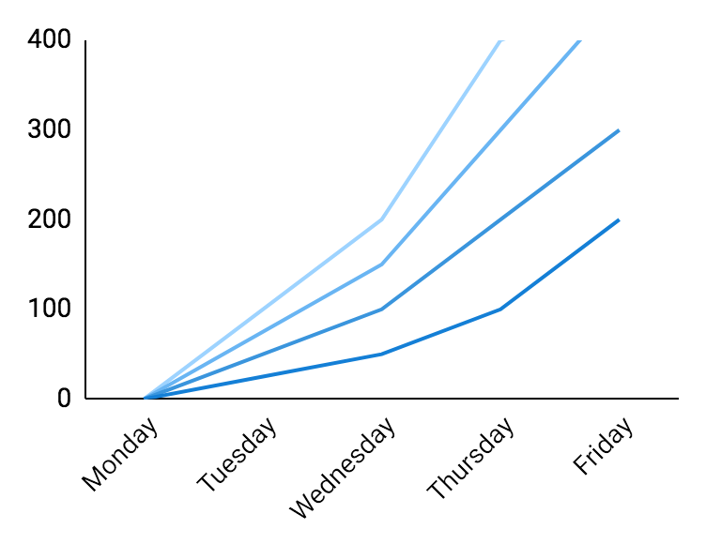
Ultimate spreadsheet charts for business infographics
01
02
Jupiter
Mercury
Jupiter is the biggest planet of them all
Mercury is the closest planet to the Sun
Venus
Pluto
Venus has a nice name but is very hot
Pluto is considered a dwarf planet
03
04
Follow the link in the graph to modify its data and then paste the new one here. For more info, click here

Slide 32
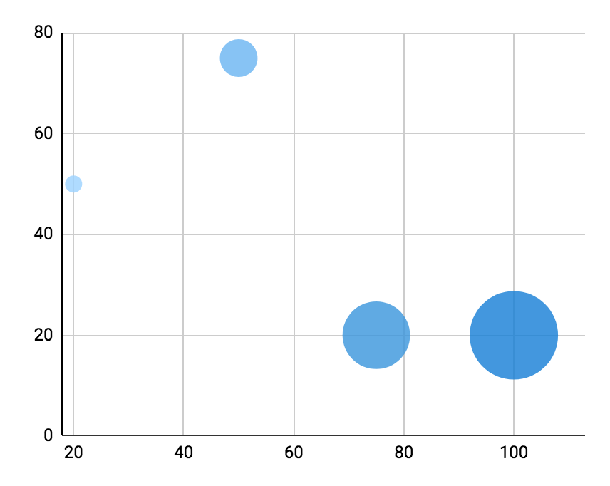
Ultimate spreadsheet charts for business infographics
Neptune
Neptune is the farthest planet from the Sun
Mars
Despite being red, Mars is a cold place
Pluto
Pluto is considered a dwarf planet
Ceres
Ceres is located in the main asteroid belt
Follow the link in the graph to modify its data and then paste the new one here. For more info, click here

Slide 33
Instructions for use
If you have a free account, in order to use this template, you must credit Slidesgo in your final presentation. Please refer to the next slide to read the instructions for premium users.
As a Free user, you are allowed to:
- Modify this template.
- Use it for both personal and commercial projects.
You are not allowed to:
- Sublicense, sell or rent any of Slidesgo Content (or a modified version of Slidesgo Content).
- Distribute Slidesgo Content unless it has been expressly authorized by Slidesgo.
- Include Slidesgo Content in an online or offline database or file.
- Offer Slidesgo templates (or modified versions of Slidesgo templates) for download.
- Acquire the copyright of Slidesgo Content.
For more information about editing slides, please read our FAQs or visit Slidesgo School:
https://slidesgo.com/faqs and https://slidesgo.com/slidesgo-school

Slide 34
Instructions for use (premium users)
As a Premium user, you can use this template without attributing Slidesgo.
You are allowed to:
Modify this template.
Use it for both personal and commercial purposes.
Hide or delete the “Thanks” slide and the mention to Slidesgo in the credits.
Share this template in an editable format with people who are not part of your team.
You are not allowed to:
Sublicense, sell or rent this Slidesgo Template (or a modified version of this Slidesgo Template).
Distribute this Slidesgo Template (or a modified version of this Slidesgo Template) or include it in a database or in any other product or service that offers downloadable images, icons or presentations that may be subject to distribution or resale.
Use any of the elements that are part of this Slidesgo Template in an isolated and separated way from this Template.
Register any of the elements that are part of this template as a trademark or logo, or register it as a work in an intellectual property registry or similar.
For more information about editing slides, please read our FAQs or visit Slidesgo School:
https://slidesgo.com/faqs and https://slidesgo.com/slidesgo-school

Slide 35
Infographics
You can add and edit some infographics to your presentation to present your data in a visual way.
Choose your favourite infographic and insert it in your presentation using Ctrl C + Ctrl V or Cmd C + Cmd V in Mac.
Select one of the parts and ungroup it by right-clicking and choosing “Ungroup”.
Change the color by clicking on the paint bucket.
Then resize the element by clicking and dragging one of the square-shaped points of its bounding box (the cursor should look like a double-headed arrow). Remember to hold Shift while dragging to keep the proportions.
Group the elements again by selecting them, right-clicking and choosing “Group”.
Repeat the steps above with the other parts and when you’re done editing, copy the end result and paste it into your presentation.
Remember to choose the “Keep source formatting” option so that it keeps the design. For more info, please visit Slidesgo School.

